Slide 1

AISC2011 Data Science Project Management and Requirement Gathering (PMAI)
Winter Semester 2025
Tuesdays 3-4PM
Soumo Mukherjee

Slide 2
Agenda - Weeks 1,2 – Course Outline
Attendance
Learning Outcomes
Meet & Greet
Housekeeping
Course Breakdown

Slide 3
Learning Outcomes
Understand the goal of this course
Understand the importance of project management
Learn to work in Teams
Be able to track projects
Be able to communicate in a team

Slide 4
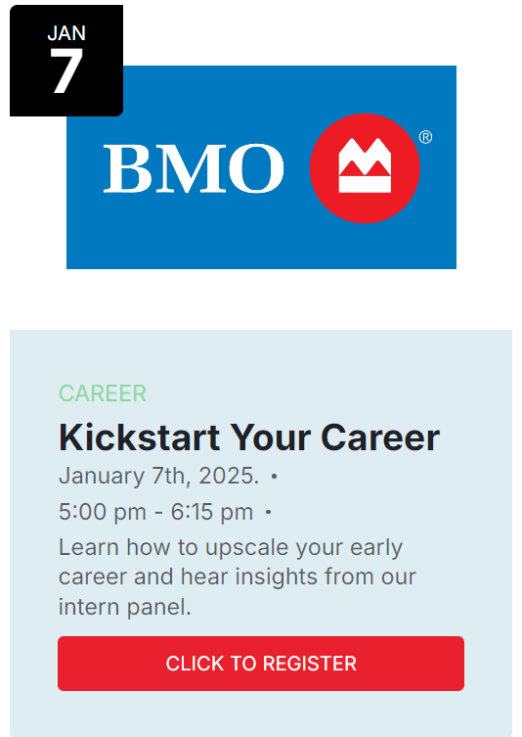
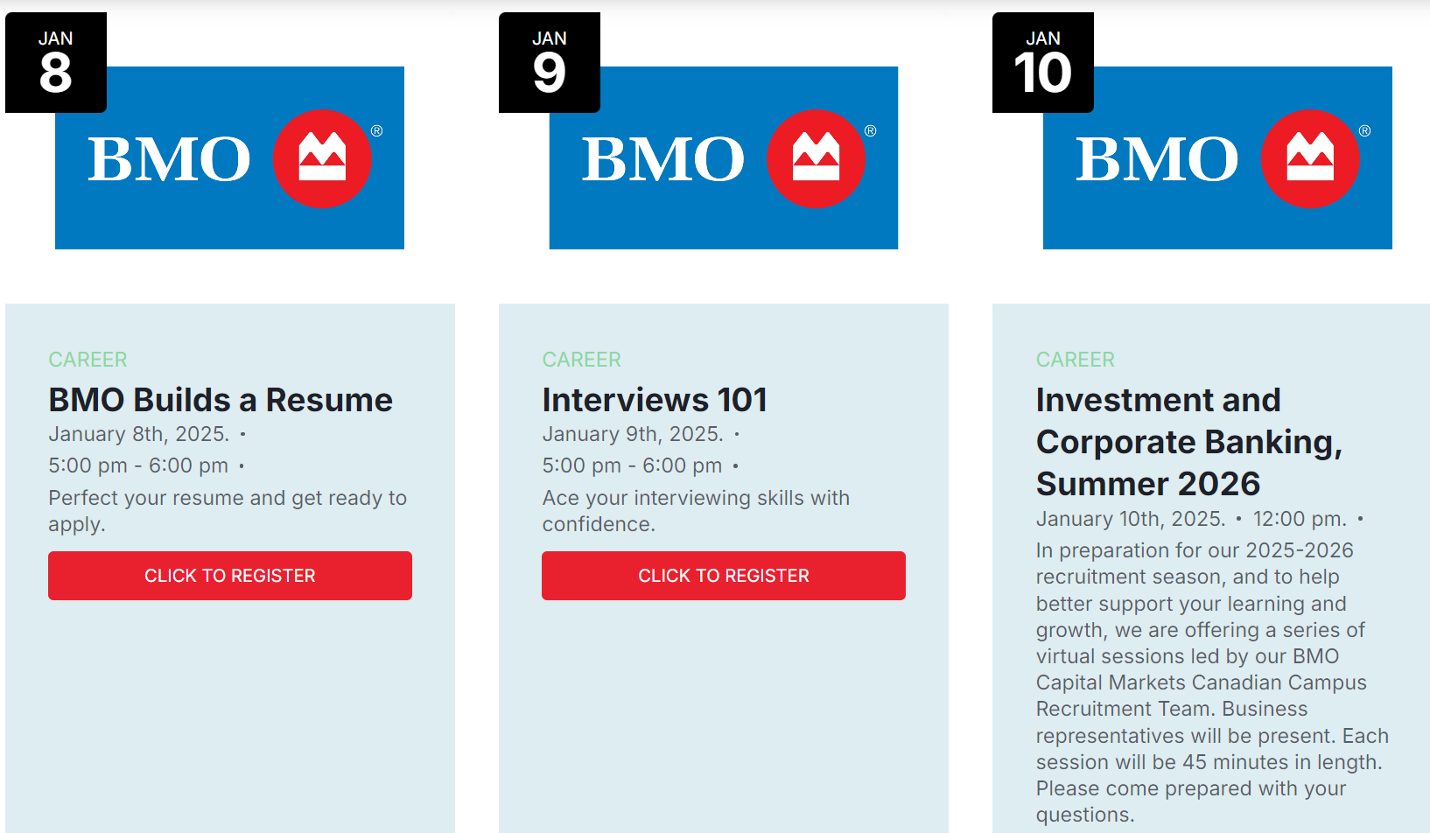
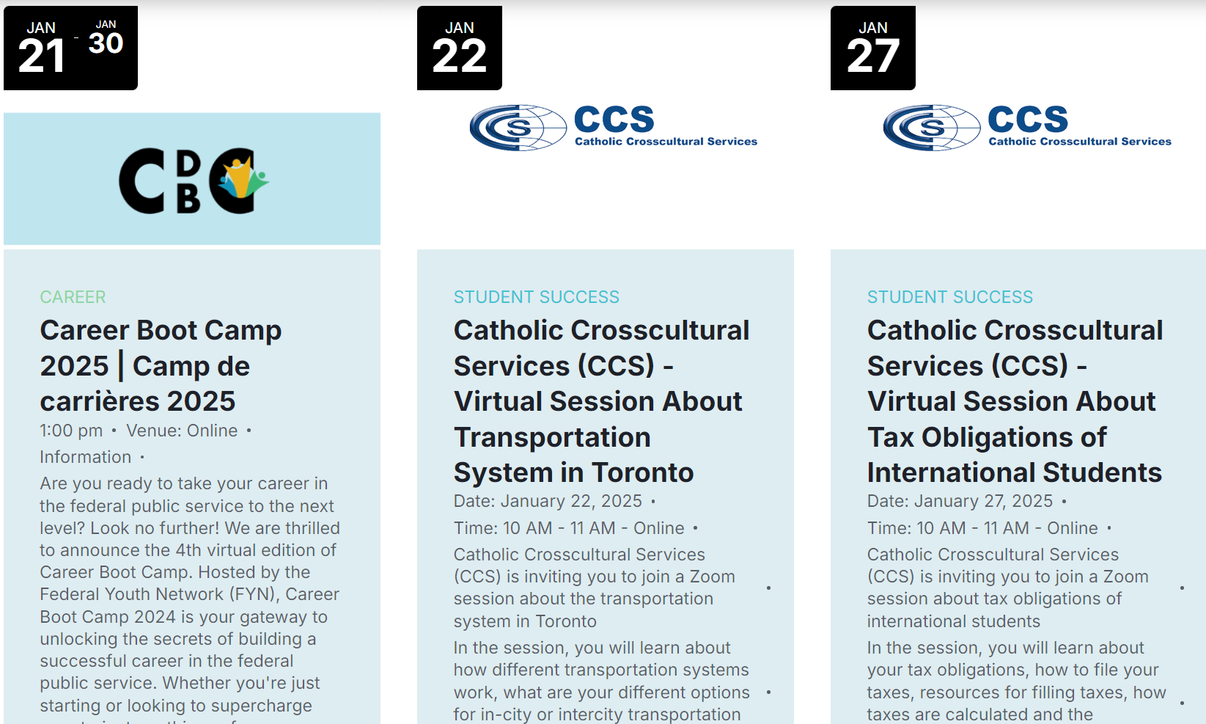
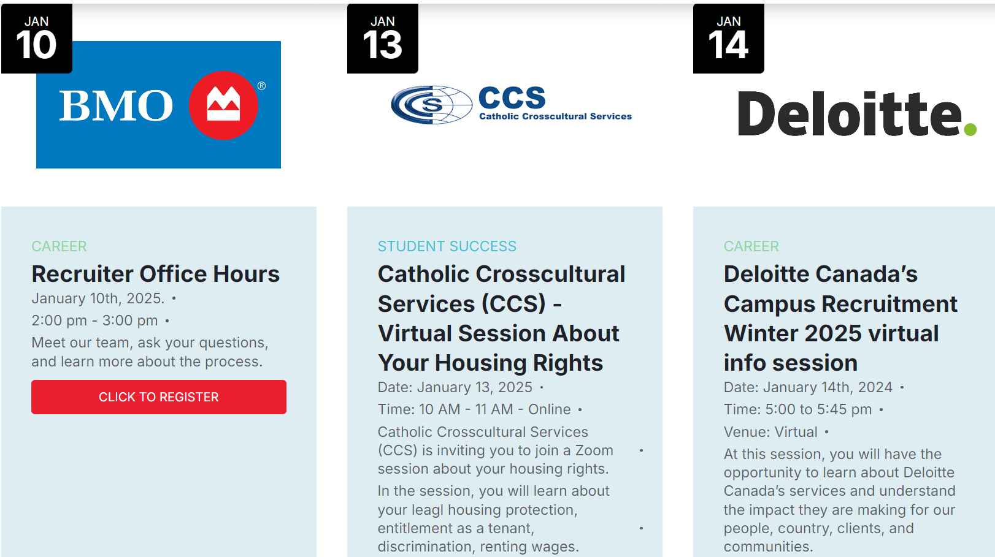



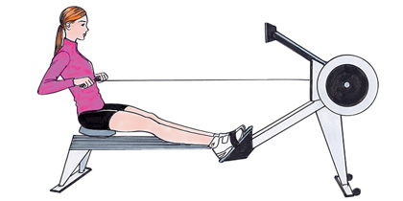
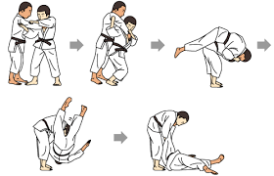


About Me
Roots in the GTA
Scholarship:
Experience: Academia (UT, McGill, UQàM), Industry (AUiLabs);
Likes:

Slide 5
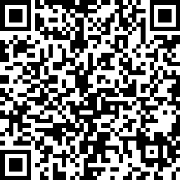
Project Management as a Career
Join us for our free virtual event on Wednesday, October 23, 2024. 7:00 to 8:30pm.
Agenda
What is a Project Manager?
Project Management job trends
Pulse of the Profession - The Future of Project Work
PMI Certifications
“A Day in the Life” of a project management professional
Could this be for you? Q&A session

Slide 6
Housekeeping - Success
As of now you all have 100%! Work hard, maintain it. I WANT you to succeed!
Attendance is up to you, but I strongly encourage it. I will take attendance, but you will not be graded on it*. If you are unable to attend, let me know.
*week-to-week but you must attend your presentations/projects.
Please read: Student Code of Conduct – Positive Learning & Living Environment (AOP 209)
Refrain from/understand: Cheating, Plagiarism, Falsification, Misrepresentation, Fraudulent Behaviour
Communicate with me. I am understanding, accessible, and want you to succeed. Don’t wait until you are in trouble.
LATE POLICY: -100% per second on submissions & attendance (you may not start assignments/cs late)
DO NOT USE ANY AI TOOLS IN THIS COURSE! I am not concerned with grammar/spelling, so do not use GRAMMARLY etc.
Past ADRs: you may not sit beside a co-ADR group member

Slide 7
Housekeeping - Success
Seat reservation policy: NO reserved seats, first-come, first-served; if there is an empty seat with terminal, you must use it; Login when you arrive to class, activate office etc.; no laptops
No social media in class?
No detectable phones; or leave class until next week
If you need to talk, buy shoes etc. leave for 15 minutes at least before re-entering
Do NOT interrupt presentations
Pay attention during presentations
No recording in class without my permission
Testing on terminals only

Slide 8
Housekeeping - timetable
week | Theme | Objectives |  | Evaluation
1/2 – Apr 29/May 6 | Introduction | Create plans, add details… MS Project
3 – May 13 | In-class Assignment#1 – 10%
4 – May 20 | Agile | Sprints, scrums
5 – May 27 | In-class Assignment#2 – 10%
6 – Jun 3 | Req. gathering | Business Obj. vs. DS, Stakeholder Engagement; Requirements Gathering; Framing/Scoping
7 – Jun 10 | Midterm Exam – 20%
8 – Study Week | -
9 – Jun 24 | Overview/Req | DS vs…; AI/MLOps Lifecycle; Roles/responsibilities; Methodologies
10 – Jul 1* -async? | In-class Assignment#3 – 10%
11 – Jul 8 | In-class Assignment#4 – 10%
12 – Jul 15 | Resources/Risks | Data sourcing, Team/Time/Budget allocation | Data sourcing, Team/Time/Budget allocation/Planning, Evaluation/Management
13 – Jul 22 | Case Study #1 -10%
14 – Jul 29 | Case Study #2 -10%
15 – Aug 5 end 4PM | Final Exam – 20%

Slide 9
Project Management as a Career
Join us for our free virtual event on Wednesday, October 23, 2024. 7:00 to 8:30pm.
Agenda
What is a Project Manager?
Project Management job trends
Pulse of the Profession - The Future of Project Work
PMI Certifications
“A Day in the Life” of a project management professional
Could this be for you? Q&A session

Slide 10
M.S. Project: Management Skills for Planning and Controlling Projects
Assabet After Dark

Slide 11
Week One: Learning Objectives
We’ll talk a bit about projects in general
We’ll practice using Microsoft Project to:
Create project plans that include your tasks, and your resources (people, equipment).
Organize and format your project details
Track actual work against the plan
Take corrective action when things get off track.

Slide 12
Week One: Projects Defined
What is a project?
What are the types of projects that Microsoft Project would be useful for planning, scheduling, and controlling?
A project is a temporary endeavor that has a beginning and an end. A project also produces a unique deliverable or end result. It takes:
Time
Resources
People
Equipment that costs money over time, or that has to be scheduled

Slide 13

Week One: Project Management
Project Management as a profession
The Project Management Institute, PMI
Their web site is http://www.pmi.org/
The Project Management Professional Exam, the “PMP” exam
A Guide to the Project Management Body of Knowledge, the “PIMBOK”
Rita Mulcahy’s PMP Exam Prep book is a best seller.
Her web site is: http://www.rmcproject.com/

Slide 14
Week One: Microsoft Project Uses
Microsoft Project would be useful for scheduling:
A wedding
A movie shoot
A construction project
The First Night festivities in Boston
It would be less useful for scheduling ongoing operations
The weekly staff schedules for wait staff at a restaurant
An endeavor that doesn’t have an ending

Slide 15
Week One: Microsoft Project Uses
Why use Microsoft Project?
As opposed to Microsoft Excel, for example
Microsoft Project has some similarities to Excel. It’s strength over excel is in its scheduling engine.
The difference between a to-do list and a Gantt chart
You’ll see throughout this course that you can set when specific tasks on your to do list must start or end.

Slide 16
Week One
You can set dependencies in Microsoft Project.
This task can’t start until another task starts.
Or a task can’t start until another task ends.
You can also assign resources to tasks.
So, who does what.
Or, for equipment that you have a finite amount of, and you need to schedule it, you can tell with Microsoft Project if you’ve accidentally sent two film crews out at the same time, and you have only one camera.

Slide 17
Week One: Microsoft Project Uses
Costs
You can track:
Hourly costs for employees
Equipment rentals
And easily see what large chunks of your project will cost
You can also track change with Microsoft Project.
So, if someone wants a change that will delay a single task by only one day, but a lot of other tasks can’t start until it’s complete, Microsoft Project could automatically take into account the ripple effect, and show you your new completion date.

Slide 18
Week One: Getting Help
Tips for getting help with Microsoft Project
Microsoft.com has tips and tutorials
Go to www.microsoft.com and search for “Microsoft Project” to find the Project home page, as well as a free 60-day trial of the latest version.
The direct link for it: http://office.microsoft.com/en-us/project/FX100487771033.aspx
In Microsoft Project, under the Help menu, choose “Microsoft Office Project Help.” That opens up the Project Help window.

Slide 19
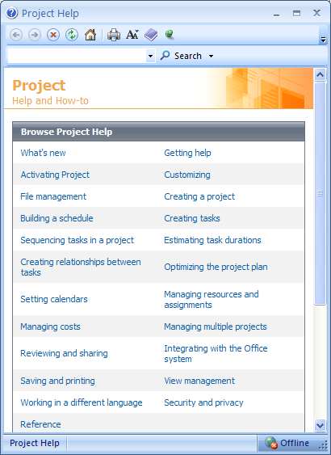
Week One: Getting Help
The Project Help window

Slide 20
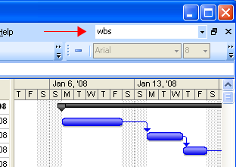
Week One: Getting Help
You can also get this window by typing text in the search box, and hitting the enter key.

Slide 21
Week One: Getting Help
Microsoft also has an extensive knowledgebase at:
support.microsoft.com
They also have Microsoft Product Support Services, at:
support.microsoft.com/gp/overview/

Slide 22
Week One: Chapter One
Managing a simple project
Chapter one learning objectives
Start project standard, identify the major parts of the project window
Use views
Use reports
Create a project plan and enter a project start date.
Set the working and non-working time for a project.
Enter a project plan’s properties.

Slide 23
Week One: Chapter One
Now, it’s important to consider that Microsoft Project is just a tool that can help you manage projects. Before you can get started with Microsoft Project, you have to consider the following things about your project:
Your task list. What tasks must be performed? In what order?
Anything that’s not in scope is out of scope. Anything that’s not on your task list will be forgotten.

Slide 24
Week One: Chapter One
When should your tasks be performed?
When and in what order are not necessarily the same. Dependencies.
Who will complete the tasks?
How much will it cost?

Slide 25
Week One: Appendix A
Let’s digress into Appendix A, “A Short Course on Project Management.”
The PIMBOK’s definition of a project:
“A temporary endeavor undertaken to create a unique product or service.”
It could be a week, it could be a year.
It has to have an end date, even if the end date is flexible, or unknown.
Resources, such as equipment and people, need to do work.
They require planning, rather than being spontaneous endeavors.

Slide 26
Business Decision-making
All projects have in common that they are trying to accomplish something
Either create a product, deliver a service, make a decision, offer information…
This is typically accomplished by breaking down a complex problem into smaller steps that are each easier to solve

Slide 27
Business Decision-making
All steps, regardless of size, require informational and analytics supports
BI systems rely on some form of Data Warehousing to fuel insight and supporting managerial decision-making
Business Information falls under:
descriptive: the problem’s what is/was
predictive: “” what will/would
prescriptive: what needs/should be done

Slide 28
Stakeholders
Stakeholders are anyone/thing connected to the project whose considerations are important to outcomes, methods, successes
A stakeholder can be a person:
shareholder, CEO, employee, community member…(in AI: end-users, data scientists, developers)
A stakeholder can be an entity:
governmental body (e.g. EPA), another business (B2B), trade association… (in AI GDPR)

Slide 29
Stakeholders
Stakeholders have concerns over the project, company, outcomes…
e.g. budgets, compliance (e.g. tax laws), impacts (e.g. pollution concerns)…
Expectations can be aligned (common desire) or non-aligned (competing or unrelated)…
e.g. saving on budget will help the company and the client if the savings are split between profit and savings
e.g. saving on budget might increase company profit but not affect client tax burden
e.g. saving budget may decrease government tax revenue

Slide 30
Stakeholders
Stakeholders are not all equal
Some have greater influence on the project
e.g. GDPR > CEO > Data Scientist
Some may impact the project differently
e.g. If Data scientist quits, that creates a problem and the hierarchy may need shifting/managing
Establish stakeholder priority according to influence, power, liability

Slide 31
Stakeholder Expectations
Expectations are dynamic (can change over time –quickly in AI) and require management
e.g. saving on budget helps the client, but then they realize they need to speed up the timeline, so more workers need to be hired reducing that savings
e.g. client understands the project deadline is set, but then there is a worker strike and the project will be late
Expectations need to be managed
-preferably as soon as possible (communications)
-transparently/honestly (reputational harm is real!)
-while preserving relationships (all walk away happy)
-hierarchically (primary, secondary…priority stakeholders)

Slide 32
Managing Stakeholder Expectations
Managing Expectations requires:
-frequent communications (before, during (updates), after (outcomes)) to build/maintain trust/transparency and prove reliability
-realism (“it is better to under promise and over deliver than to overpromise and under deliver” vs. just tell the truth)
In many systems there is a trade-off: speed, $, quality –pick two! A client needs to understand the trade-offs so that if there are decisions to be made, they can offer insights into their priority. Clients need to know that AI changes quickly and they should prepare to adapt.

Slide 33
Managing Stakeholder Expectations
Managing Expectations requires:
-exhaustive communications
(All parties must be heard. Sometimes they may wish to be silent, but it is important to have their view known.) In AI there is a wide, divergent understanding of technology. All must be on the same page. AI concepts/jargon should be simplified, benefits, limitations, and risks understood.
-dispute resolution infrastructure ahead of time
It is important while heads are cool, to set up a robust system for conflict management which should have escalation steps, authority control, default positions, timelines, procedural guidelines and be adaptable.

Slide 34
Managing Stakeholder Expectations
E.g. AI-powered healthcare
WHO wishes to create an AI diagnostics system (using X-rays, MRIs, and CT scans to identify illnesses). The hope is to improve accuracy, patient care and quality of life). The team is multidisciplinary including data scientists, developers, medical professionals and government bodies and benefactors –and of course patients).
Outline the stakeholders.
Are they all aligned?
How do we manage expectations?

Slide 35
Managing Stakeholder Expectations
WHO Executives
-want higher accuracy, less medical errors, increased branding
Doctors
-afraid for jobs (AI displacement), want good patient outcomes
Patients
-want faster/accurate diagnoses, and good outcomes
Authorities
-want safe/reliable AI, complying with medical regulations
Data Scientists/Developers
-want to increase accuracy, branding
Donors
-want to maximize impact for their dollar

Slide 36
Managing Stakeholder Expectations
Realistic Goals
DS will work with CEOs to convey best/worse case accuracy, timeline, costs. CEO will tell donors, patients that they can expect…and doctors that the system will likely not replace…
Updates via demo/transparent communication
Regular progress can be demonstrated throughout the software lifecycle (prototyping to release) to show donors and physicians what they can expect and progress that is not coming out of thin air. This also provides opportunity to input into the decision-making process, and address concerns.

Slide 37
Managing Stakeholder Expectations
Doctor feedback
Is used in dev so that accuracy is increased and they can see and understand fears regarding their jobs.
Ethicals
WHO will have to reach out to different jurisdictions such as the UN, FDA, CDC, ECDC, NHS, CIHR, CCDC…and explain the AI system meets ethical/legal standards. They should emphasize patient safety, data privacy and share data and preliminary findings.

Slide 38
Managing Stakeholder Expectations
Risk Management
After preliminary findings, AI limitations are revealed. All stakeholders must be warned so they can work together to iterate and improve.
Addressing Doctors
The CEO and DS reach out to physician bodies and show how the AI makes their job easier so they can work on the harder, less mundane tasks.
-they are handheld through the process.
-stethoscope/Merck manual did not replace physicians

Slide 39
Managing Stakeholder Expectations
Stakeholder | Best case | Likely | Worst case
WHO
Doctor
Patient
Authorities
Technical teams
Donors
Fill

Slide 40
Stakeholder Outcomes
Stakeholder | Best case | Likely | Worst case
WHO |  |  | Money loss, reputational harm, law suits, angry donors
Doctor | Free time/better care on hard cases |  | Job loss
Patient | Faster, cheaper, better, accessible care
Authorities | All laws met | Negotiation, updates | Non-compliance
Technical teams
Donors | High accuracy… |  | Money wasted

Slide 41
Managing Stakeholder Exercise
Explain how to handle the variances. Identify who tells/does what to whom. Was any of it preventable?
-The top donor is indicted for fraud and cannot deliver 30% of the funding.
-The top donor is indicted for fraud, but wants WHO to testify on their behalf.
-WHO leadership changes. The new CEO is interested in community-led care and not technology.
-Doctors go on strike in protest.
-Doctors sue WHO in court over false accuracy claims.
-Patients in rural Outerpotamialand refuse medical care “from a robot”.
-Patients refuse to pay higher taxes/fees in protest of AI-doctors.
-The FDA leader had no authority to greenlight the project, halfway through.
-The NHS has announced new measures to safeguard against AI error. All results need to be vetted by a human.
-The developer team lead gets hired by a rival company.
-The developer team lead loses her laptop that had the code/data.

Slide 42
Week One: Appendix A
There’s a unique deliverable produced.
The “triple constraint,” or the “project triangle.”
Cost
Time
Quality
Scope

Slide 43
Week One: Appendix A
When working with your project sponsor, it’s a good idea to define which of the three things on the project triangle are fixed, and which are flexible.
Everything you do in Microsoft Project will be striking a balance between time, cost, and scope.

Slide 44
Week One: Appendix A
Time:
For the Fourth of July fireworks, the deadline would be more important than the cost, or than the scope.
You’d rather have a smaller show on the Fourth of July than a great show in August.
And you might pay more than planned if you had to, to get the fireworks on the Fourth.

Slide 45
Week One: Appendix A
Cost
Your cost will include hourly pay for people who work on your project
Equipment rentals
Materials that get used throughout the project
All the other events and issues that cost money throughout your project.
Cost constraints
A fixed price contract
You can only use in-house people in your organization

Slide 46
Week One: Appendix A
Cost constraints, cont’d:
You’ve been allocated a fixed amount to do the project. A $5,000 grant to create a public art installation.
Scope
Product scope versus project scope
Product scope: the intended quality, features, and functions of the product
Project scope: everything that needs to get done in order to produce the product.

Slide 47
Week One: Appendix A
Scope constraints
Engineering projects would have very finely documented specifications. Let’s say your company has won a contract to develop an automotive product that has exact requirements, with physical measurements down to 0.01 mm.
You’re constructing a building with a height restriction of 50 feet.
You have to use in-house services, and they have their own product management methodology.

Slide 48
Week One: Appendix A
When the project triangle gets skewed:
Time
Cost
Or…
Cost
Time
Quality
Quality
Scope
Scope
Decreased scope and time, but higher cost.
If your cost is decreased, you may have to decrease your scope, and increase your time.

Slide 49
Week One: Appendix A
If the duration (time) of your project schedule decreases
You may have to increase the budget (cost), because you may have to hire more resources to do the same work in less time.
Watch your project scope and quality
If the budget (cost) decreases
You might need more time.
Let’s say you can’t hire the ideal number of people, or people with the best skills.
You might have to use lesser quality materials. Try to maintain a balance between cost, scope, and quality.

Slide 50
Week One: Appendix A
If your project scope increases
You might need more time or money.
Scope creep
Changes to the project scope after it’s been agreed upon, quoted, and scheduled.
Have a formal procedure for managing change requests.
Who authorizes them?
Outline the chain of command throughout your project team, and make it clear with your sponsor who to go to.
What actions should you take as a team to decide if you can (not) accommodate the change?
How should your project sponsor request them?
You can give them a formal scope change request form.
Document what the turn-around time will be for a yea or nay, and that changes to the scope may result in changes to the time, cost, and quality of the project.

Slide 51
Week One: Appendix A
Managing Your Projects with Project (page 482)
Track information about the work, duration, and resource requirements of your project
Visualize your project plan
Schedule tasks and resources
Exchange project information with stakeholders.
Communicate with resources (staff) and other stakeholders.

Slide 52
Week One: Back to Chapter One
The exercises in this book focus around a fictitious film production company, Southridge Video and Film Productions.
There are no practice files for chapter one.
Microsoft Project Standard versus Microsoft Project Professional. We’re using the Standard version.
Part 4 of our book covers the ‘Professional’ version.

Slide 53
Week One: Chapter One
A big advantage that Project has over other software applications, like Excel or like Visio, is that it has a scheduling engine, a brain.
If you have a project with 100 tasks in it, and you change the duration of task 50, it will have a ripple effect. It will reschedule your other tasks for you.
You can immediately tell your sponsor how the change will impact, the time and cost.

Slide 54
Week One: Chapter One
Starting Project Standard
We’re on page 6
On your taskbar, click the Start button.
Go to All Programs > Microsoft Office > Microsoft Office Project 2007.
Your screen will look similar to this:

Slide 55
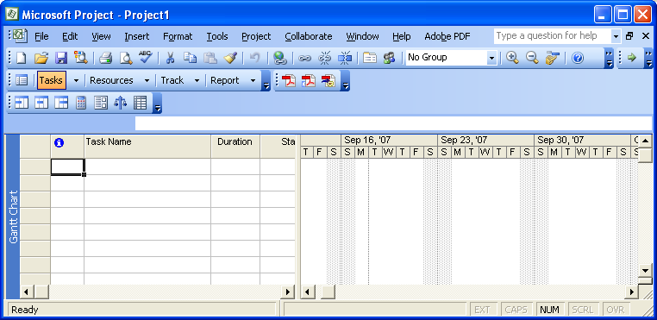
Week One: Chapter One
Click the down arrow to see more tools
Search for help
Toolbars Menu Bar
Gantt Chart view
The name of the active view appears here.

Slide 56
Week One: Chapter One
The toolbars can change. Project automatically customizes them, based upon which tools you use most.
Project is installed with a lot of templates to get you started.
On the File menu, click New.
Under Templates, click On computer.
Click the Project Templates tab.

Slide 57
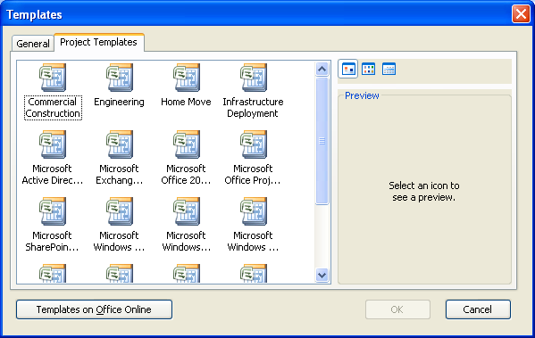
Week One: Chapter One
You’ll see this window:

Slide 58
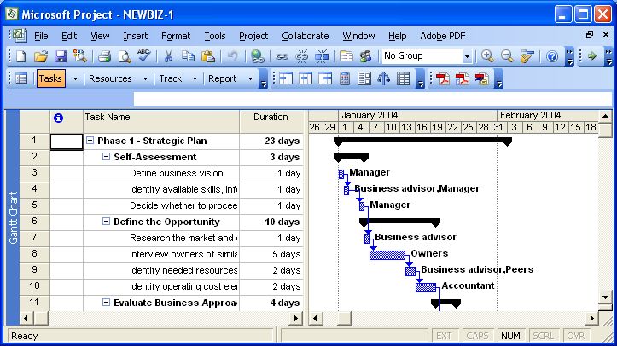
Week One: Chapter One
Click New Business, and click OK. Your screen should look like this:

Slide 59
Week One: Chapter One
The Project Guide
View menu > Turn on Project Guide
Or, under the Tools menu > Options > Interface tab, check the checkbox Display Project Guide.
Note: in the book, we’re skipping pages 11-18, on “Starting Project Professional,” since we’re working with Project Standard.

Slide 60
Week One: Chapter One
Exploring Views
Click on the View menu, and select the various views.
The Gantt chart view is the one that you’ll likely use the most often.
Try the View menu > Resource Sheet.

Slide 61
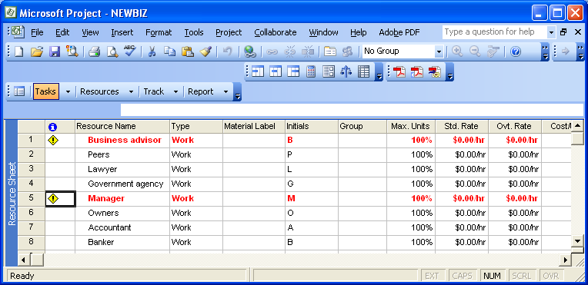
Week One: Chapter One
In this example, the resources are people, but they’re generic. “Lawyer,” instead of the name of a specific lawyer.

Slide 62
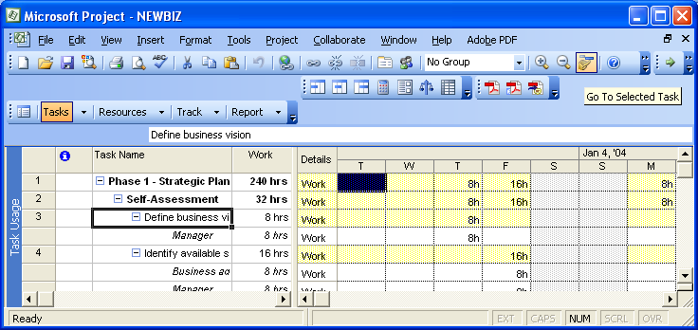
Week One: Chapter One
On the View menu, try Task Usage.
Click on task 3, Define Business Vision. Then click on the Scroll to Task button.
The timescale appears.

Slide 63
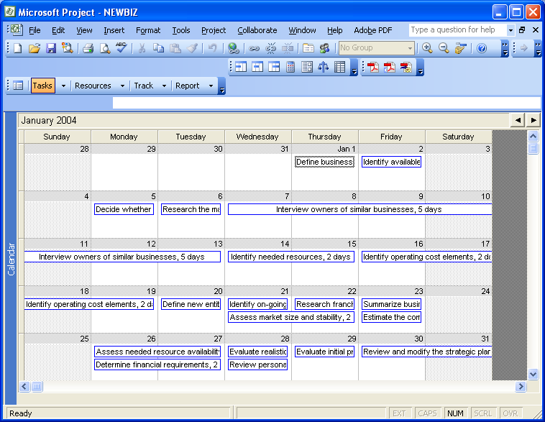
Week One: Chapter One
Try the View menu > Calendar.
This would be a good view to print and share with your project sponsor. It doesn’t show dependencies, or who does what, but it’s simple and easy to read.

Slide 64
Week One: Chapter One
Let’s take a look at the Network Diagram
View menu > Network Diagram.
In project management practice, this is also known as the Activity on Node network, or an AON.
We’ll see a bit later on that the AON helps you to see the dependencies that tasks have on one another. Which tasks have to be complete in order for other tasks to start or finish.

Slide 65
Week One: Chapter One
Combination views
On the View menu, click Gantt Chart.
On the View menu, click More Views.
In the Views box, click Task Entry, and then click the Apply button.
You’ll see the Gantt Chart at the top of the Project window, and the Task Form view at the bottom.

Slide 66
Week One: Chapter One
Up in the Gantt chart view, select task 3, Define Business Vision. You’ll see the details about that task in the Task Form.
Amongst other details, we see the “Resource Name” here, and how much work the resource has been assigned to the task.
Also, you can display any two views you want by clicking on the Window menu, and choosing Split. Undo it by clicking back on the Window menu, and choosing Remove Split.

Slide 67
Week One: Chapter One
Exploring Reports
There are two types of reports in Project:
Reports that are for printing
Reports that are for exporting Project data to other software applications, like Excel and Visio.
On the Report menu, click Reports.
Note: In Project 2003, this was under View > Reports. There was not a Reports menu.
Choose Custom, and then click the Select button. You’ll see the Custom Reports dialog box.

Slide 68
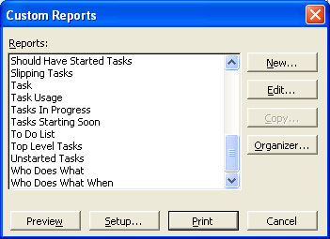
Week One: Chapter One
There are lot of great reports in here:
Choose Resource > Work > Preview.

Slide 69
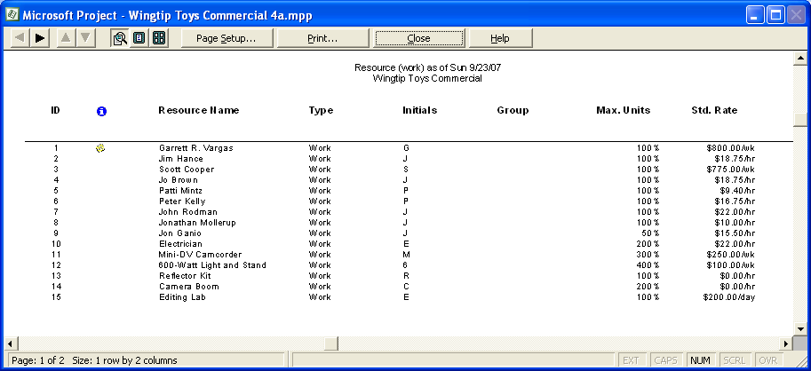
Week One: Chapter One

Slide 70
Week One: Chapter One
The most you can do is print this report. You can zoom in and out, and flip pages in it. It’s really a print preview window.
You can’t use it for data entry.
That what all of the reports in Microsoft Project are like.
Views let you edit the information.
Reports are for printing it.
Click Close > Close to close out of the Reports dialog box.

Slide 71
Week One: Chapter One
Back under the Reports menu, click Visual Reports.
You have to have Excel installed for this to work (Excel 2003 or later).
I believe that this is new as of Project 2007.
You’ll see a list of predefined visual reports in Project.
Project can export to either Microsoft Project or Microsoft Visio, and then use those applications to create fancy stuff.

Slide 72
Week One: Chapter One
Choose the Resource Remaining Work Report, and then click View.
If all goes well, you should see a bar chart in Excel.
Close Excel, and in Project, click Close to close the Visual Reports dialog box.

Slide 73
Week One: Chapter One
Creating a new project plan
Specify only the start date, or the finish date (in most cases)
Project will calculate the other date for you, once you give it the durations for your tasks
Usually you’ll use the start date. An exception would be an event with a very important end date, like the Fourth of July Fireworks, or the First Night festivities.

Slide 74
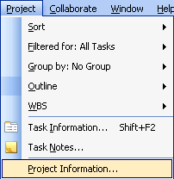
Week One: Chapter One
Let’s create a new project plan
On the File menu, click New. In the New Project pane, click Blank Project.
On the Project menu, click Project Information.

Slide 75
Week One: Chapter One
Go to the Standard toolbar, and click Save.
On your computer, there should be folders for all of the practice files that correspond with our book. Hopefully you’ll already be at the My Documents folder. Browse to here:
My Documents\Microsoft Press\Project 2007 SBS
The full path is:
C:\Documents and Settings\Jennifer\My Documents\Microsoft Press\Project 2007 SBS
Open the Chapter 1 Getting Started folder
In the File Name box, type Wingtip Toys Commercial 1, and click Save.

Slide 76
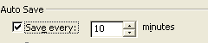
Week One: Chapter One
To have Project autosave, for example, once every 10 minutes:
Go to the Tools menu > Options, select the Save tab, and set this:

Slide 77
Week One: Chapter One
Set Nonworking Days
We’ll be using the project calendar.
We’ll set the working time and the non-working time
Do you have a second shift, or an overnight shift? Will people be working on the project on weekends?
You’ll want to put in holidays, vacation days, and any other breaks.
How finite you need to be here, though, depends a lot on the types of projects you’re managing.

Slide 78
Week One: Chapter One
For example, a complicated surgery, involving multiple doctors, might require very tight scheduling.
For a software development project, that’s taking two years, on the other hand, you might only need to schedule tasks down to the week, not down to the day or down to the hour.
On the Tools menu, click Change Working Time.

Slide 79
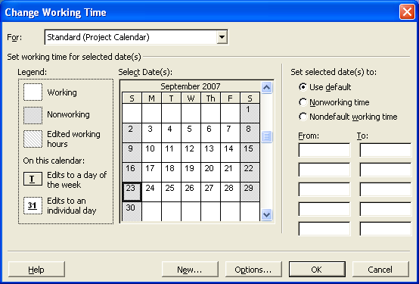
Week One: Chapter One
You’ll get this dialog box:

Slide 80
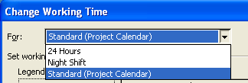
Week One: Chapter One
In the “For calendar” drop-down menu, you have three choices:
24-hours – there’s no non-working time
Night shift – Monday night through Saturday morning, 11pm – 8am
Standard – 8am to 5pm Monday through Friday

Slide 81
Week One: Chapter One
Leave the calendar set at “Standard (Project Calendar)
Let’s make an exception – everyone has January 28th off, for a morale event.
In the Exceptions tab, under the Name field, type “Staff at morale event.”
In the Start field, type 1/28/08, and then press Enter (on your keyboard).
Or, you can select the date in the calendar, or you can select it from the drop-down menu in the Start field.

Slide 82
Week One: Chapter One
That date’s now scheduled as non-working time for this project.
Click OK to close the Change Working Time dialog box.
Scroll to Monday, January 28th in the Gantt Chart view. You’ll see that it’s greyed out.
A handy thing:
Use the zoom buttons to zoom in and zoom out on the Gantt Chart view, to make it easier to find that date.

Slide 83
Week One: Chapter One
Entering Project Properties
These are used in the headers and footers of reports that you print from Project.
They’re things like statistics, how many times the file has been revised, or things you’d want to record, like the project manager’s name.
On the File menu, click Properties.
Make sure the Summary tab is selected.
In the Subject box, type Video Production Schedule.
In the Author box, type your name.
In the Manager box, type your name, or your manager’s name (make stuff up…).

Slide 84
Week One: Chapter One
In the Company box, type Southridge Video.
Select the Save preview picture check box.
What this check box does:
Without it checked, the next time you open this file, you’ll see the default project icon:

Slide 85
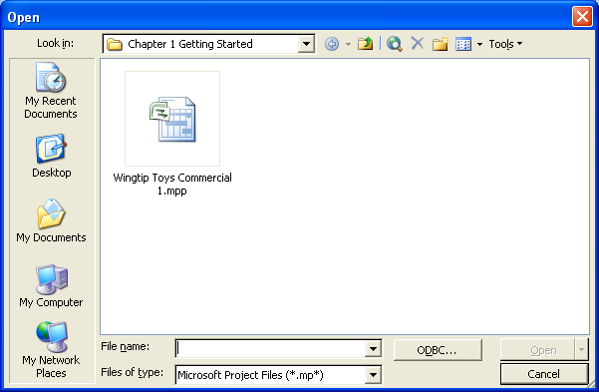
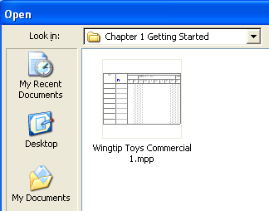
Week One: Chapter One
If you check that checkbox, though, it generates a preview image that shows the first few tasks of the project in it.
The default
Looks like the Gantt chart

Slide 86
Week One: Chapter One
Click OK to close the dialog box.
Close the Wingtip Toys Commercial 1 file.

Slide 87
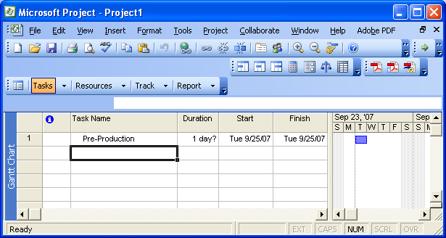
Week One: Chapter Two
3. In the first cell directly below the Task name column heading, type Pre-Production and then press the enter key on your keyboard.
Bar representing task
Default estimated duration
ID number. Now, that represents the order in which tasks are entered.

Slide 88
Week One: Chapter Two
The duration – the question mark means it’s an estimate – you haven’t entered anything in for it, so it defaults to:
1 day?
The default start date is the same as the project start date.

Slide 89
Week One: Chapter Two
Enter the following task names below Pre-Production, pressing Enter after each one:
Develop Script
Develop Production Boards
Pick Locations
Hold Auditions
Production
Rehearse
Shoot Video
Log Footage

Slide 90
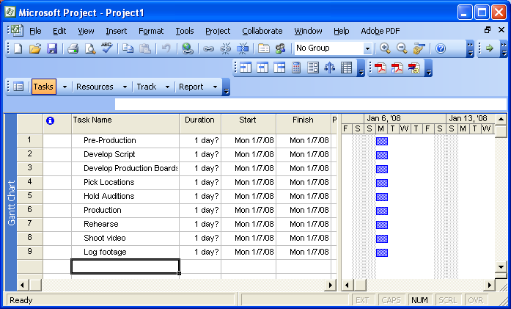
Week One: Chapter Two
So, your Gantt chart view should look like this:

Slide 91
Week One: Chapter Two
Estimating Durations
Default
Poll
Past History
Guess?
Worst-case
Best-case
Acceptable risk
Dependency-based
…

Slide 92
Week One: Chapter Two
What if I already have a lot of tasks entered into another application, like Excel?
From Microsoft Office Project Help:
Click Open.
In the Files of type box, click the file type you want to import data from.
To import data from a SQL Server or Oracle Server format, click ODBC to connect to your data source, and then continue with step 5.
In the Look in box, locate the folder that contains the file you want to import, and then select the file in the file list.
If needed, you can search for the file.
Click Open.
Follow the instructions in the Import Wizard to import the data you want into the proper Microsoft Office Project 2003 fields.

Slide 93
Week One: Chapter Two
Now, the Wizard is most straightforward if you have a heading in your Excel file for your tasks, named “Name”.
Also, chapter 12 of our book does a good job of explaining how to do this.
Here’s an example. I made a simple Excel spreadsheet, like so (and I’ve zoomed in on it):

Slide 94
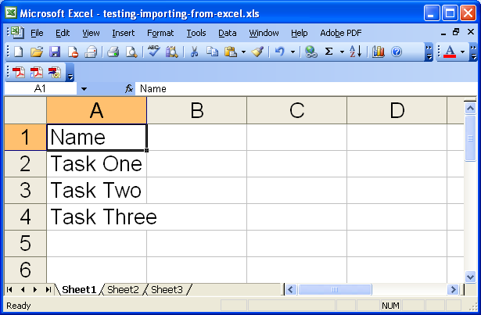
Week One: Chapter Two

Slide 95
Week One: Chapter Two
Now, in Project, with a project file open already, click on the File menu, and then click Open.
You’d think we’d be looking for an “import” choice, but no.
In the Files of Type drop-down menu, choose Microsoft Excel Workbooks (.xls)
Browse to the Microsoft Excel file, select it, and click Open.

Slide 96
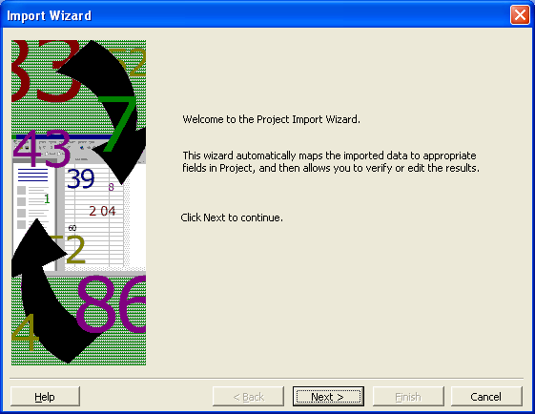
Week One: Chapter Two
The Project Import Wizard will appear:

Slide 97
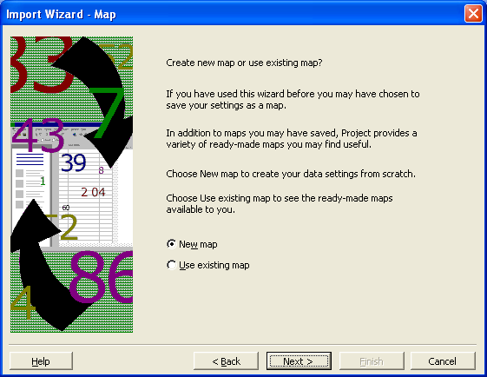
Week One: Chapter Two
Click Next.
It’ll ask you if you want to create a new map or use an existing map. Choose New Map, and click Next.

Slide 98
Week One: Chapter Two
It’ll ask you “How do you want to import this file?” The choices are:
As a new project
Append data to the active project
Merge the data into the active project
Try appending.

Slide 99
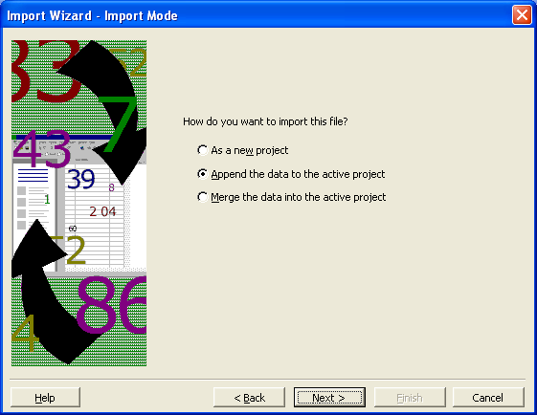
Week One: Chapter Two
And click Next.

Slide 100
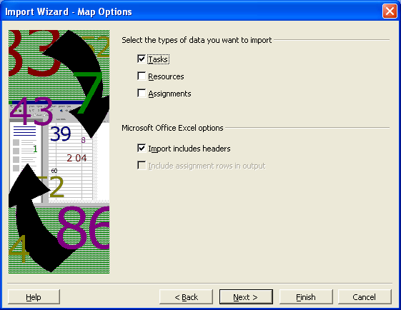
Week One: Chapter Two
It’ll ask you to select the types of data you want to import. We’re trying tasks, so choose Tasks. Also, under “Microsoft Office Excel Options,” check off Import includes headers. And click Next.

Slide 101
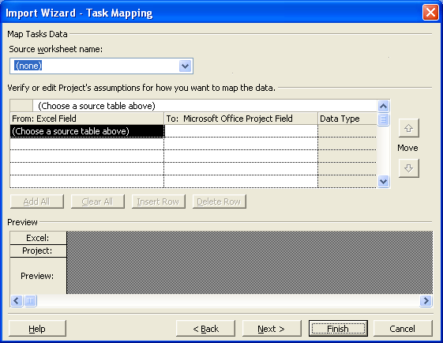
Week One: Chapter Two
First you’ll see this:
In here, Source worksheet name, choose Sheet 1.

Slide 102
Week One: Chapter Two
Then it’ll map the fields from Excel for you automatically, matching the header named Name in your Excel file with the field named Name in Project, which is the Task Name field in the Gantt chart.

Slide 103
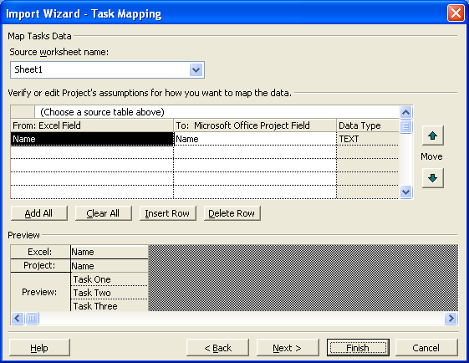
Week One: Chapter Two
So, it filled this in:
And it found the values from Excel
Click Next.

Slide 104
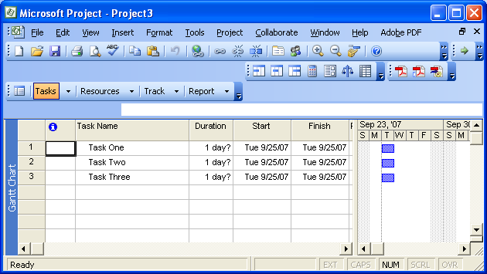
Week One: Chapter Two
You can save your new map if you want to. Or, click Finish.
It should import them:

Slide 105
Week One: Chapter Two
A task’s duration can range from minutes to months in Project.
You’ll probably want to use hours, days, or weeks, not minutes or months.
Let’s say that you’ve set up your project calendar with working time defined as 8:00am through 5:00pm, with a one-hour lunch break, Monday through Friday.
If you estimate that a task will take 16 hours of working time, you could enter in “2d”

Slide 106
Week One: Chapter Two
So, if the task starts at 8:00am on Friday, when will it complete?
The overall duration of a project is the difference between the earliest start date and the latest finish date of its tasks.
A task’s duration and elapsed time are not necessarily the same.
Working time and non-working time.
Task relationships.

Slide 107
Week One: Chapter Two
In Project, you can abbreviate durations.
30m, 5h, 2d, 1w, 2mo, for example.
If you enter: | It appears like: | And means:
m | min | minute
h | hr | hour
d | day | day
w | wk | week
mo | mon | month

Slide 108
Week One: Chapter Two
Elapsed duration
If you want to schedule something that happens over nonworking time. Like “wait for concrete to cure” or “wait for paint to dry.”
No one’s on the clock during it.
The next task after it is dependent upon its completion, though.
Use the abbreviation “ed”, so “2ed” is 2 elapsed days.

Slide 109
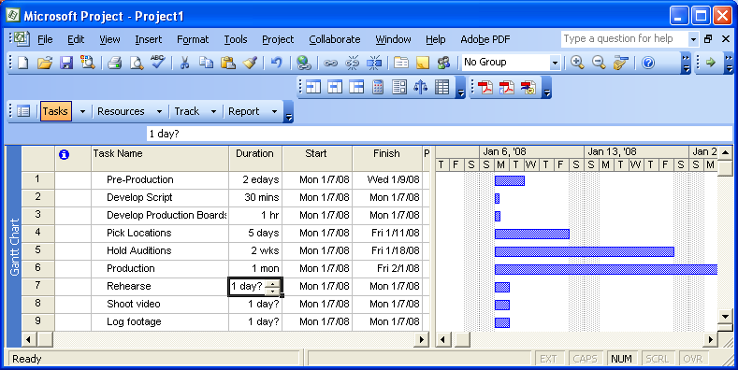
Week One: Chapter Two
So, try playing with these durations.

Slide 110
Week One: Chapter Two
By default, in Project:
One minute = 60 seconds
One hour = 60 minutes
If you wanted to define non-standard durations for days, weeks, months:
Go to the Tools menu > Options
Click the Calendar tab

Slide 111
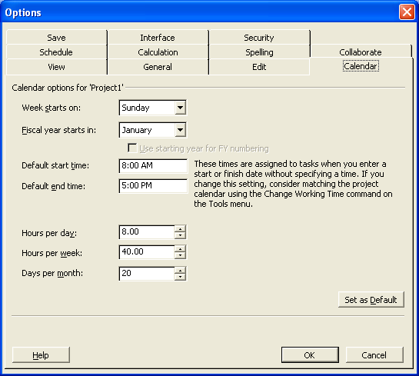
Week One: Chapter Two
Hours per day is 8. Entering 2d, for 2 days, is the same as entering in 16 hours.
40 hours per week.
So, 3 wks is the same as 120 hours.
20 days per month.
So, 1 mo is the same as 160 hours. 8 hours per day x 20 days.

Slide 112
Week One: Chapter Two
Exercise, pages 42-43
Enter durations for the tasks you’ve entered.
For the task “Develop Script,” click the Duration cell.
Type 5d, and press enter.
For the rest of them:

Slide 113
Week One: Chapter Two:
Task ID | Task Name | Duration
3 | Develop Production Boards | 3d
4 | Pick Locations | 2d
5 | Hold Auditions | 2d
6 | Production | Skip this one
7 | Rehearse | 2d
8 | Shoot video | 2d
9 | Log footage | 1d

Slide 114
Week One: Chapter Two
Check out how the bars in the Gantt chart change.
On project management:
Coming up with accurate task durations
The overall project duration generally tends to correlate – long projects have long tasks. Short projects have short tasks.
Consider the level of detail you need and want to track. Too much detail causes unnecessary work.
Measure down to the level of detail that you need to, to control the project.

Slide 115
Week One: Chapter Two
In the book, the durations are supplied for you. Things to use to estimate task durations:
Historical information from past, similar projects
Estimates from the people working on the project
Expert judgment of people who have managed similar projects
Professional or industry standards

Slide 116
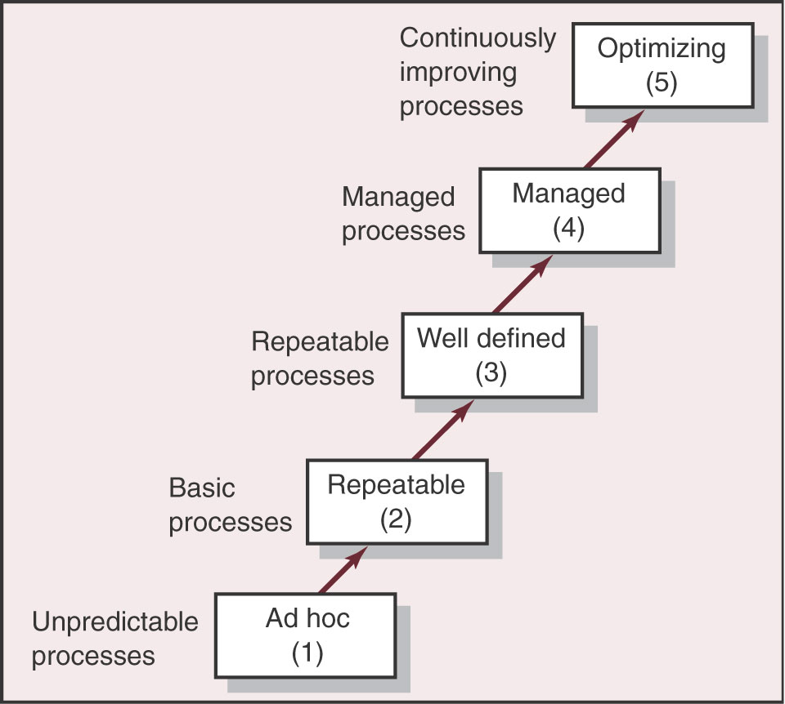
Week One: Chapter Two
Capability Maturity Model (CMM)
This is a tipping point which started off model inclusion as part of computerized decision support, & BI tools (esp. in analytics).
Very typical is the use of centralized Big Data platforms to incorporate the sheer volume of data in these models.
Source: Project Management: The Managerial Process, Gray and Larson http://highered.mcgraw-hill.com/sites/0072493925/
Highest risk

Slide 117
Week One: Chapter Two
The temptation to put a lot of padding into your schedule
Risk
Bidding on a contract – you may have to outdo your competitor
Identify exactly where you need padding, why you need it
You should be able to explain to your sponsor every last piece of the project plan, every last task

Slide 118
Week One: Chapter Two
The 8/80 rule
The smallest task should be no smaller than 8 hours
The largest should be no larger than 80 hours
It’s just a rule-of-thumb. It depends highly on your project.
Exercise: Entering a milestone (page 44)
1. Click the name of task 6, Production.
2. On the Insert menu, click New Task.
3. Type Pre-Production Complete! Then press the tab key to move to the Duration field.

Slide 119
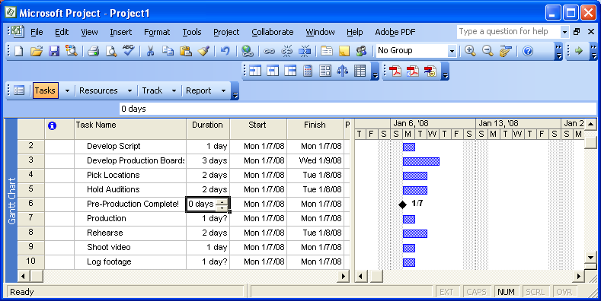
Week One: Chapter Two
4. In the Duration field, type 0d and then press the Enter key.
It adds a milestone to your plan.

Slide 120
Week One: Chapter Two
If you want to make a task that has a duration into a milestone:
Double-click the task name, to open the Task Information dialog box.
Click the Advanced tab.
Select Mark as Milestone.

Slide 121
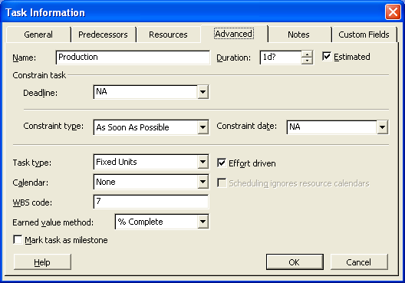
Week One: Chapter Two
The Mark task as milestone checkbox

Slide 122
Week One: Chapter Two
Organizing tasks into phases
Pre-production, production, post-production
A summary task behaves differently from other tasks.
You can’t edit its duration or start date, or other calculated values. They’re derived, or “rolled-up” from the subtasks contained within the summary task.
Top-down and bottom-up planning

Slide 123
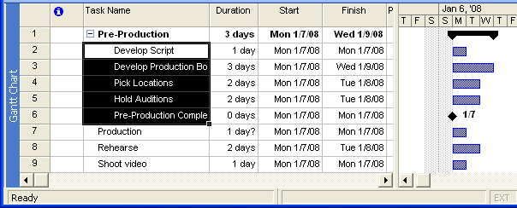
Week One: Chapter Two
Exercise: create summary tasks
1. Select the names of tasks 2 through 6.
2. On the Project menu, go to Outline, and then click Indent.
Task 1 becomes a summary task.

Slide 124
Week One: Chapter Two
You can use the indent/outdent buttons instead.
If you don’t see those buttons on your toolbar, then
At the right end of your toolbar, click on the down arrow.
Click on Add or Remove Buttons.
Click on Formatting.
Check off Indent and Outdent. (Illustrated on the next slide)

Slide 125
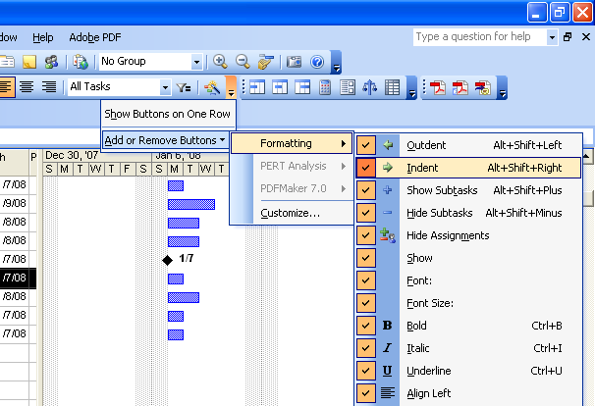
Week One: Chapter Two

Slide 126
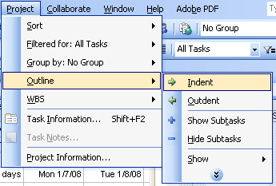
Week One: Chapter Two
3. Next, select the names of task 8 through 10.
4. On the Project menu, point to Outline, and then click Indent.

Slide 127
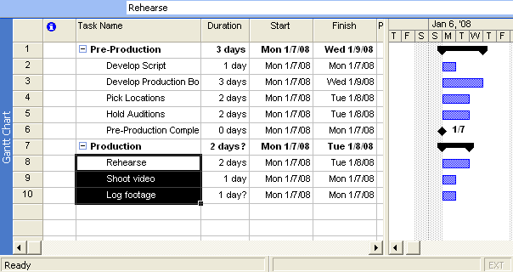
Week One: Chapter Two
Task 7 becomes a summary task.
Summary task
Summary task bar

Slide 128
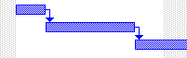
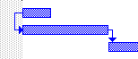


Week One: Chapter Two
Linking Tasks
Finish to start (FS)
Start to Start (SS)
Finish to Finish (FF)
Start to Finish (SF)
There’s an exercise on pages 49-51

Slide 129
Week One: Chapter Two
Ways to link tasks
The chain icon, unchain icon
Highlight two tasks, and then on the Edit menu, click Link Tasks.

Slide 130
Week One: Chapter Two
Highlight a task.
On the Project menu, click Task Information.
Click the Predecessors tab.
Click the empty cell below the Task Name heading, and click the down arrow.
Select another task (Rehearse is the task in the example).

Slide 131
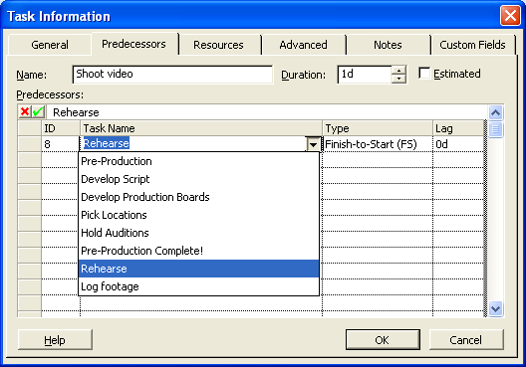
Week One: Chapter Two
It filled in Finish to Start (FS)

Slide 132
Week One: Chapter Two
Linking tasks that aren’t next to each other
Select a task
Hold down the control key
Select another task
Link tasks using any of the methods above
You can link summary tasks to each other.
You can also link tasks right in the Gantt chart.

Slide 133
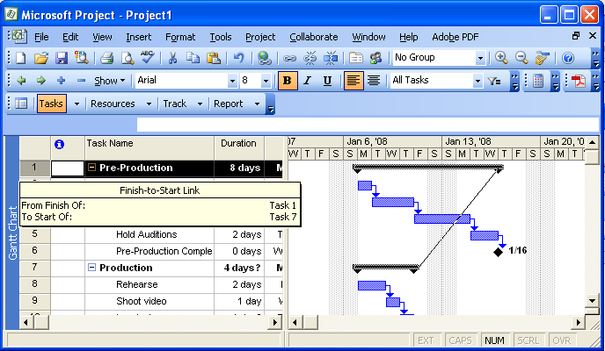
Week One: Chapter Two
Click and drag from one bar to the other

Slide 134
Week One: Chapter Two
Another way to link non-adjacent tasks
Select the task you want to be the successor task.
Click the Task Information button on the Standard toolbar, and then click the Predecessors tab.
In the Task Name column, select the predecessor task you want.
The task information button:

Slide 135
Week One: Chapter Two
To enter lead or lag time between linked tasks
Select the successor task.
Click the Task Information button on the Standard toolbar, and then click the Predecessors tab.
In the Lag field, enter the lag time (positive value) or lead time (negative value) you want.

Slide 136
Week One: Chapter Two
To change the link type between two tasks
Select the successor task.
Click the Task Information button on the Standard toolbar, and then click the Predecessors tab.
Select the successor task, In the Type field, select the link type you want (Finish to Start, Start to Finish, et cetera)

Slide 137
Week One: Chapter Two
So, we saw four ways to link tasks
The Link Tasks button
The Edit Menu > Link Tasks
The Project menu > Task Information, Predecessors tab
Clicking and dragging directly from one Gantt chart bar to another

Slide 138
Week One: Chapter Two
Documenting tasks
Task notes
Exercise on page 53
There’s a Task Notes button on the Standard toolbar:
Project menu > Task Notes
Right-click the task name, and choose Task Notes
Screentips

Slide 139
Week One: Chapter Two
Create a hyperlink
Select a task
On the Insert menu, choose Hyperlink.
You can also click the Insert Hyperlink button, or right-click on a task and choose Hyperlink.
Text to Display and the Address
Checking the Plan’s Duration
Project has estimated the duration of the project for you.

Slide 140
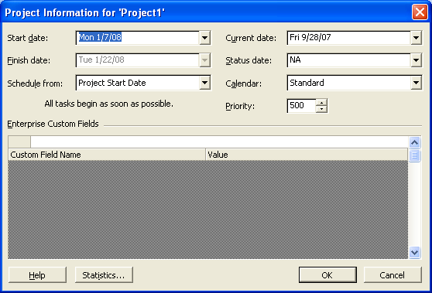
Week One: Chapter Two
Project menu > Project Information
It estimated this for you
Note: This screenshot is from Project Professional, not Project Standard. It has an “Enterprise Custom Fields” box as well.

Slide 141
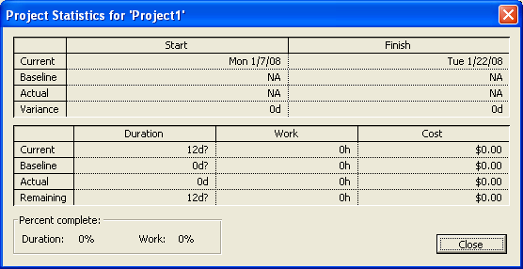
Week One: Chapter Two
On that Project Information dialog box, click the Statistics button.
Let’s look at the current finish date and the current duration.

Slide 142
Week One: Chapter Two
Change the timescale, so you can see the complete project
View menu > Zoom.
Select Entire Project, and click OK.
Look at the Gantt chart. It will have changed how far zoomed in it is.
You can also use the zoom in and zoom out buttons to do the same thing.

Slide 143
Chapter 2 Glossary
baseline The original project plan, saved for later comparison. The baseline includes the planned start and finish dates of tasks and assignments and their planned costs. Each Microsoft Project file can have at most one baseline.

Slide 144
Chapter 2 Glossary
bottom-up planning Developing a project plan by starting with the lowest-level tasks before organizing them into broad phases.
deliverable The final product, service, or event a project is intended to create.

Slide 145
Chapter 2 Glossary
dependency A link between a predecessor task and a successor task. A dependency controls the start or finish of one task relative to the start or finish of the other task. The most common dependency is finish-to-start, in which the finish date of the predecessor task determines the start date of the successor task.

Slide 146
Chapter 2 Glossary
duration The length of working time you expect it will take to complete a task.
elapsed duration The total length of working and nonworking time you expect it will take to complete a task.

Slide 147
Chapter 2 Glossary
Entry table The grid in the left side of the default Gantt Chart view.
field The lowest-level information about a task, resource, or assignment; also called a cell.

Slide 148
Chapter 2 Glossary
Gantt Chart view One of several predefined views in Microsoft Project. The Gantt Chart view consists of a table (the Entry table by default) on the left side and a graphical bar chart on the right side.
link A logical relationship between tasks that controls sequence and dependency. In the Gantt Chart and Network Diagram views, links appear as lines between tasks.

Slide 149
Chapter 2 Glossary
milestone A significant event that might be reached within the project or imposed upon the project. In Microsoft Project, milestones are normally represented as tasks with zero duration.
predecessor A task whose start or end date determines the start or finish of another task or tasks, called successor tasks.

Slide 150
Chapter 2 Glossary
product scope The quality, features, and functions (often called specifications) of the deliverable of the project.
project scope The work required to produce a deliverable with agreed-upon quality, features, and functions.

Slide 151
Chapter 2 Glossary
relationship The type of dependency between two tasks, visually indicated by a link line. The types of relationships include finish-to-start, start-to-start, finish-to-finish, and start-to-finish. Also known as a link, a logical relationship, a task dependency, or a precedence relationship.

Slide 152
Chapter 2 Glossary
risk Any event that decreases the likelihood of completing the project on time, within budget, and to specification.
shortcut menu A menu you display by pointing to an item on the screen and then clicking the right mouse button. Shortcut menus contain only the commands that apply to the item to which you are pointing.

Slide 153
Chapter 2 Glossary
sequence The chronological order in which tasks occur. A sequence is ordered from left to right in most views that include a time scale, for example, the Gantt Chart view.
successor A task whose start or finish is driven by another task or tasks, called predecessor tasks.

Slide 154
Chapter 2 Glossary
summary task A task that is made up of and summarizes the subtasks below it. In Microsoft Project, phases of project work are represented by summary tasks.
Task ID A unique number that Microsoft Project assigns to each task in a project. In the Entry table, the Task ID appears in the far left column.

Slide 155
Chapter 2 Glossary
ToolTip A short description of an item on the screen, such as a toolbar button, that appears when you hover the mouse cursor over the item.
Top-down planning Developing a project plan by identifying the highest-level phases or summary tasks before breaking them into lower-level components or subtasks.

